Slide 1
FacePal
Presented by
Bishwajit Purkaystha
&
Tapos Datta

Slide 2
FacePal
A client-server desktop application which detects faces and recognizes them.
An automated the door locking system.

Slide 3
The Features
Can be remotely accessed via IP-Camera.
Renders live streaming.
Keeps a separate log file.
Lists the entrants.
Alerts administrators of any unauthorized entry via an e-mail.

Slide 4
What kind of tools are used ?
FacePal is built in JavaFx2 platform.
OpenCV version 3.1.0 used for processing of face detection.
Apache Tomcat 7.0 used in server site operations.
To manage data, MySQL database is used.
Some essential libraries are needed to develop it.

Slide 5
Libraries
Webcam-capture-0.3.10-RC7.jar
Javacpp-1.2.jar
Mail-1.4.jar
Commons-codec-1.5.jar
Colt.jar
Javacv.jar
Image-4j-0.7.jar

Slide 6
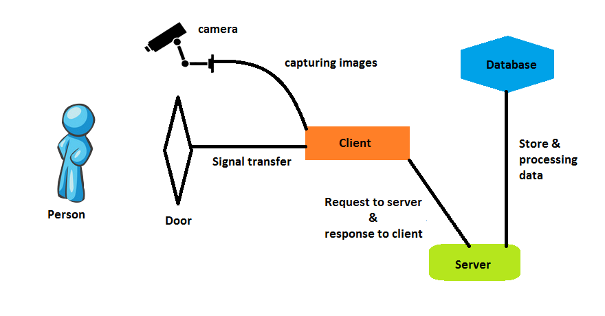
How it works

Slide 7
Steps that we chose
The entire process revolves around
Face Detection.
Face Normalization.
Calculating Eigenfaces
Face Training or Recognition

Slide 8
Face Detection and Recognition
In Face Detection process Viola Jones algorithm is used.
The algorithm has four stages:
Haar Feaures Selection.
Creating an Integral Image.
Adaboost Training.
Cascading Classifiers
Face Normalization process done by noise reduction, scaling, resizing, gray-scale conversion.
In Face Recognition a common technique for 2D face recognition known as Principal component analysis (PCA) or the eigenfaces is used.

Slide 9

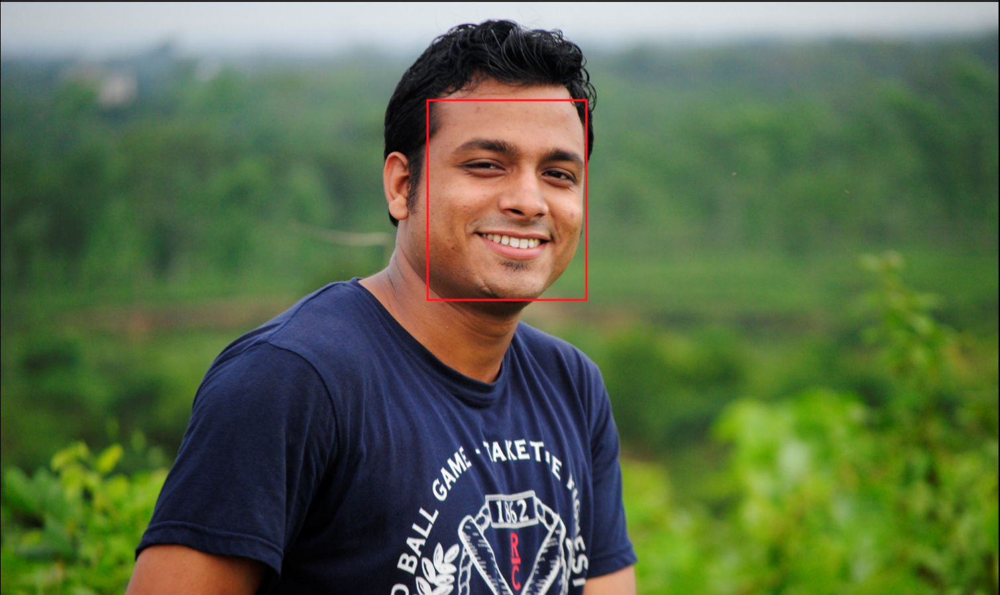
Face Detection
Before detecting face
After detecting face

Slide 10

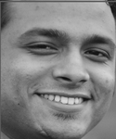
Face Normalization

Slide 11
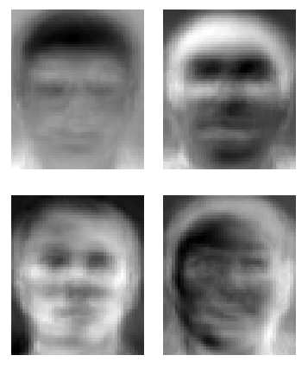
Eigenfaces
Applying PCA a set of eigenfaces are created like as

Slide 13
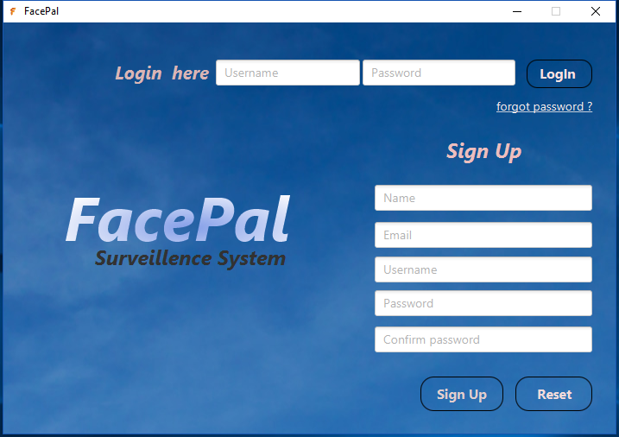
Application GUI

Slide 14
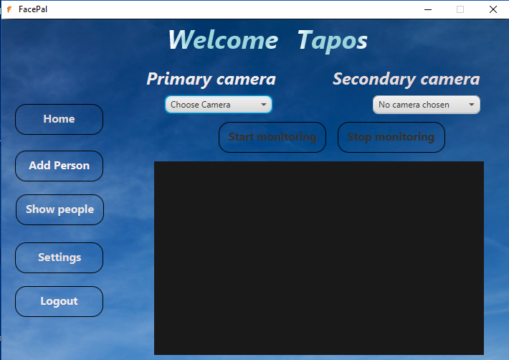
Application GUI

Slide 15
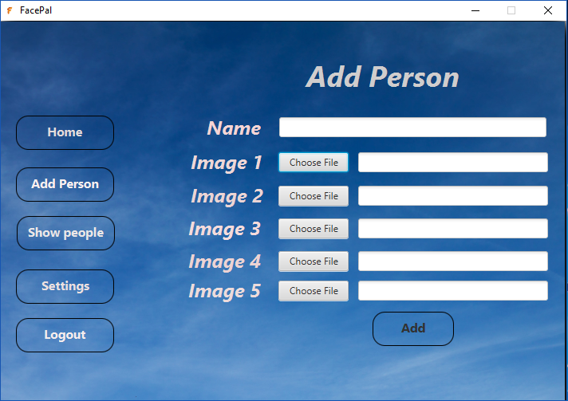
Application GUI

Slide 16
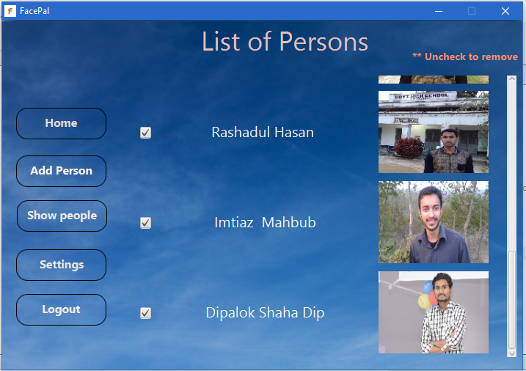
Application GUI

Slide 17
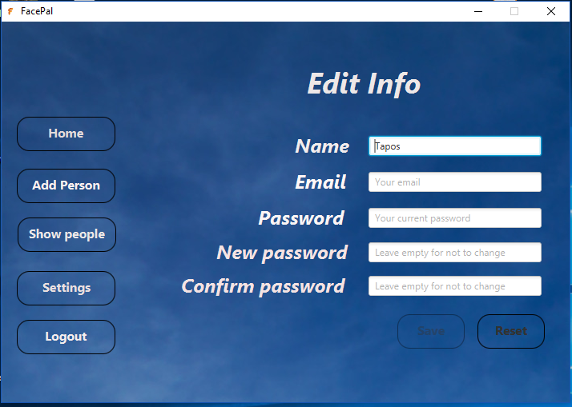
Application GUI

Slide 18
Thank you ☺

